Slide 1
Chapter 4: Making Decisions
Starting Out with C++
Early Objects
by Tony Gaddis, Judy Walters,
and Godfrey Muganda

Slide 2
Topics
4.1 Relational Operators
4.2 The if Statement
4.3 The if/else Statement
4.4 The if/else if Statement
4.5 Menu-Driven Programs
4.6 Nested if Statements
4.7 Logical Operators
4-<number>

Slide 3
Topics (continued)
4.8 Validating User Input
4.9 More About Block and Scope
4.10 More About Characters and Strings
4.11 The Conditional Operator
4.12 The switch Statement
4.13 Enumerated Data Types
4-<number>

Slide 4
4.1 Relational Operators
Are used to compare numeric and char values to determine relative order
Operators:
> | Greater than
< | Less than
>= | Greater than or equal to
<= | Less than or equal to
== | Equal to
!= | Not equal to
4-<number>

Slide 5
Relational Expressions
Relational expressions are Boolean (i.e., evaluate to true or false)
Examples:
  12 > 5 is true
  7 <= 5 is false
  if x is 10, then
  x == 10 is true,
  x <= 8 is false,
  x != 8 is true, and
  x == 8 is false
4-<number>

Slide 6
Relational Expressions
The value can be assigned to a variable
  bool result = (x <= y);
Assigns 0 for false, 1 for true
Do not confuse = (assignment) and == (equal to)
4-<number>
Notes:
See pr4-01.cpp

Slide 7
Hierarchy of Relational Operators
Use this when evaluating an expression that contains multiple relational operators
Operator | Precedence
> >= < <= | Highest
== != | Lowest
4-<number>
Notes:
See pr4-01.cpp

Slide 8
4.2 The if Statement
Supports the use of a decision structure, giving a program more than one path of execution
Allows statements to be conditionally executed or skipped over
It models the way we evaluate real-life situations
  “If it is cold outside,
  wear a coat and wear a hat.”
4-<number>

Slide 9
Format of the if Statement
if (condition)
  {
  statement1;
  statement2;
  …
  statementn;
  }
The block of statements inside the braces is called the body of the if statement. If there is only 1 statement in the body, the { } may be omitted.
No ; goes here
they go here
4-<number>
Notes:
See pr4-02.cpp

Slide 10
How the if Statement Works
If (condition) is true, then the statement(s) in the body are executed.
If (condition) is false, then the statement(s) are skipped.
4-<number>

Slide 11
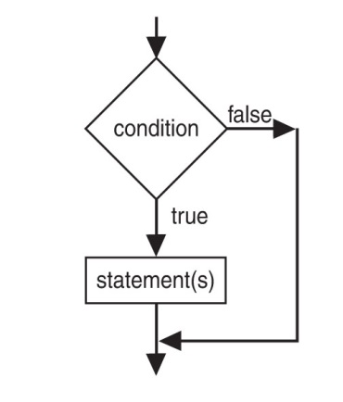
if Statement Flow of Control
4-<number>

Slide 12
Example if Statements
  if (score >= 60)
  cout << "You passed." << endl;
  if (score >= 90)
  {
  grade = 'A';
  cout << "Wonderful job!" << endl;
  }
4-<number>

Slide 13
if Statement Notes
if is a keyword. It must be lowercase
(condition)must be in ( )
Do not place ; after (condition)
Don't forget the { } around a multi-statement body
Don’t confuse = (assignment) with == (comparison)
4-<number>

Slide 14
if Statement Style Recommendations
Place each statement; on a separate line after (condition)
Indent each statement in the body
When using { and } around the body, put { and } on lines by themselves
4-<number>

Slide 15
What is true and what is false?
An expression whose value is 0 is considered false.
An expression whose value is non-zero is considered true.
An expression need not be a comparison – it can be a single variable or a mathematical expression.
4-<number>

Slide 16
Flag
A flag is a variable that signals a condition
It is usually implemented as a bool
Meaning:
  true: the condition exists
  false: the condition does not exist
The flag value can be both set and tested with if statements
4-<number>

Slide 17
Flag Example
Example:
  bool validMonths = true;
  …
  if (months < 0)
  validMonths = false;
  …
  if (validMonths)
  monthlyPayment = total / months;
4-<number>

Slide 18
Integer Flags
Integer variables can be used as flags
Remember that 0 means false, any other value means true
  int allDone = 0; // set to false
  …
  if (count > MAX_STUDENTS)
  allDone = 1; // set to true
  …
  if (allDone)
  cout << "Task finished";
4-<number>

Slide 19
4.3 The if/else Statement
Allows a choice between statements depending on whether (condition) is true or false
Format: if (condition)
  {
  statement set 1;
  }
  else
  {
  statement set 2;
  }
4-<number>

Slide 20
How the if/else Works
If (condition) is true, statement set 1 is executed and statement set 2 is skipped.
If (condition) is false, statement set 1 is skipped and statement set 2 is executed.
4-<number>
Notes:
See pr4-03.cpp

Slide 21
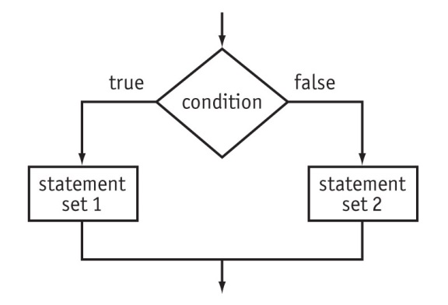
if/else Flow of Control
4-<number>

Slide 22
Example if/else Statements
if (score >= 60)
cout << "You passed.\n";
else
cout << "You did not pass.\n";
if (intRate > 0)
{ interest = loanAmt * intRate;
cout << interest;
}
else
cout << "You owe no interest.\n";
_{See pr4-04.cpp}
4-<number>
Notes:
See pr4-04.cpp

Slide 23
if vs. if/else
If there are two conditions and both of them can be true or both can be false, then use two if statements:
if (num > 0)
cout << num << " is positive\n";
if (num %2 == 0)
cout << num << " is even\n";
If the two conditions cannot both be true, then a single if/else statement can work:
if (num %2 == 0)
cout << num << " is even\n";
else
cout << num << " is odd\n";
4-<number>

Slide 24
Comparisons with floating-point numbers
It is difficult to test for equality when working with floating point numbers.
It is better to use
  greater-than or less-than tests, or
  test to see if value is very close to a given value
_{See pr4-05.cpp and pr4-06.cpp}
4-<number>
Notes:
See pr4-05.cpp and pr4-06.cpp

Slide 25
4.4 The if/else if Statement
This is a chain of if statements that test in order until one is found to be true
This also models thought processes
  “If it is raining, take an umbrella,
  else, if it is windy, take a hat,
  else, if it is sunny, take sunglasses.”
4-<number>

Slide 26
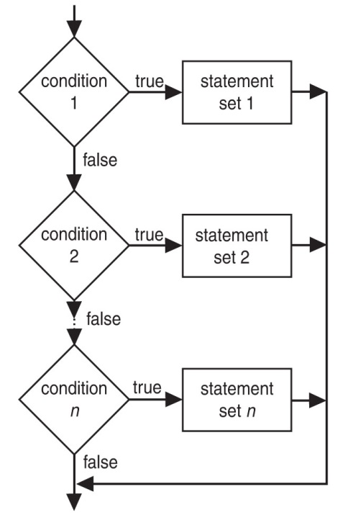
if/else if Format
  if (condition 1)
  { statement set 1;
  }
  else if (condition 2)
  { statement set 2;
  }
  . . .
  else if (condition n)
  { statement set n;
  }
4-<number>
Notes:
See pr4-07.cpp, compare to pr4-08.cpp

Slide 27
Using a Trailing else
Is used with a set of if/else if statements
It provides a default statement or action that is performed when none of the conditions is true
It can be used to catch invalid values or handle other exceptional situations
4-<number>

Slide 28
Example if/else if with Trailing else
if (age >= 21)
cout << "Adult";
else if (age >= 13)
cout << "Teen";
else if (age >= 2)
cout << "Child";
else
cout << "Baby";
See pr. 4-09
4-<number>
Notes:
See pr4-09.cpp

Slide 29
4.5 Menu-Driven Program
Menu: list of choices presented to the user on the computer screen
Menu-driven program: program execution is controlled by user selecting from a list of actions
A menu-driven program can be written using if/else if statements
4-<number>

Slide 30
Menu-driven Program Organization
Display a list of numbered or lettered choices for actions.
Input user’s selection of number or letter
Test the user selection in (condition)
  if a match, then execute code to carry out desired action
  if not, then test with next (condition)
See pr.4-10
4-<number>
Notes:
See pr4-10.cpp

Slide 31
4.6 Nested if Statements
An if statement that is part of the if or else part of another if statement
This can be used to evaluate > 1 data item or to test > 1 condition
  if (score < 100)
  {
  if (score > 90)
  grade = 'A';
  }
4-<number>

Slide 32
Notes on Coding Nested ifs
An else matches the nearest previous if that does not have an else
if (score < 100)
  if (score > 90)
  grade = 'A';
  else ... // goes with second if,
  // not first one
Proper indentation aids understanding
See pr. 4-11
4-<number>
Notes:
See pr4-11.cpp

Slide 33
4.7 Logical Operators
Are used to create relational expressions from other relational expressions
Operator | Meaning | Explanation
&& | AND | New relational expression is true if both expressions are true
|| | OR | New relational expression is true if either expression is true
! | NOT | Reverses the value of an expression; true expression becomes false, false expression becomes true
4-<number>

Slide 34
Logical Operator Examples
int x = 12, y = 5, z = -4;
(x > y) && (y > z) | true or 1
(x > y) && (z > y) | false or 0
(x <= z) || (y == z) | false
(x <= z) || (y != z) | true
!(x >= z) | false
4-<number>
Notes:
See pr4-12.cpp, pr4-13.cpp, pr4-14.cpp, and pr4-15.cpp

Slide 35
Logical Operator and bool Variables
Logicial operators can be used with bool variables as well as expressions that evaluate to true or false.
Ex:
  bool done = false;
  if ((!done) && (count < 6))
  {
  . . .
  }
4-<number>

Slide 36
Short-Circuit Evaluation
If an expression using the && operator is being evaluated and the subexpression on the left side is false, then there is no reason to evaluate the subexpression on the right side. It is skipped.
If an expression using the || operator is being evaluated and the subexpression on the left side is true, then there is no reason to evaluate the subexpression on the right side. It is skipped.
4-<number>

Slide 37
Logical Precedence
Highest !
&&
Lowest ||
Example:
(2 < 3) || (5 > 6) && (7 > 8)
is true because AND is evaluated before OR
4-<number>

Slide 38
More on Precedence
Highest
arithmetic operators
relational operators
Lowest
logical operators
Example:
8 < 2 + 7 || 5 == 6 is true
4-<number>

Slide 39
Checking Numeric Ranges with Logical Operators
Used to test if a value is within a range
  if (grade >= 0 && grade <= 100)
  cout << "Valid grade";
You can also test if a value lies outside a range
  if (grade <= 0 || grade >= 100)
  cout << "Invalid grade";
Note that you cannot use mathematical notation
  if (0 <= grade <= 100) //Doesn’t
  //work!
4-<number>

Slide 40
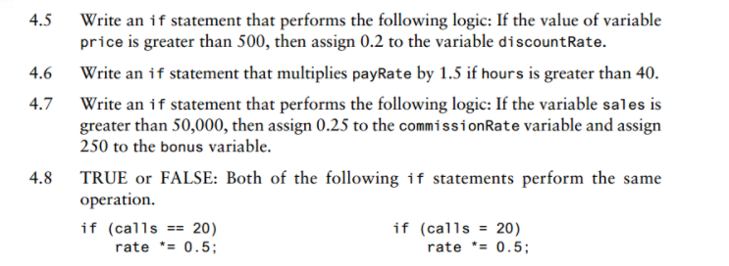
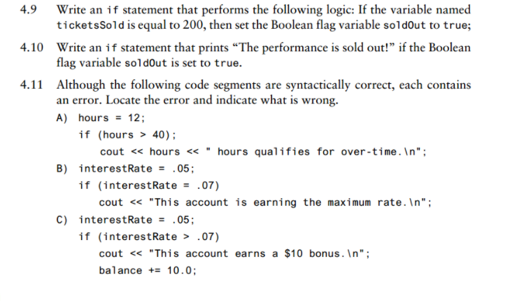
Checkpoint
1-<number>

Slide 41
4.8 Validating User Input
Input validation: inspecting input data to determine if it is acceptable
You want to avoid accepting bad input
You can perform various tests
  Range
  Reasonableness
  Valid menu choice
  Zero as a divisor
  See pr. 4-16
4-<number>
Notes:
See pr4-16.cpp

Slide 42
4.9 More About Blocks and Scope
The Scope of a variable is the block in which it is defined, from the point of definition to the end of the block
Variables are usually defined at the beginning of a function
They may instead be defined close to the place where they are first used
4-<number>
Notes:
See pr4-17.cpp

Slide 43
More About Blocks and Scope
Variables defined inside { } have local or block scope
When in a block that is nested inside another block, you can define variables with the same name as in the outer block.
  When the program is executing in the inner block, the outer definition is not available
  This generally not a good idea. The program may be hard to read or understand.
4-<number>
Notes:
See pr4-18.cpp

Slide 44
// This program uses two variables with the same name.
_{#include <iostream>}
_{using namespace std;}
_{int main()}
{
int number; // Define a variable named number
cout << "Enter a number greater than 0: ";
_{cin >> number;}
_{if (number > 0)}
{ int number; // Define another variable named number
cout << "Now enter another number: ";
_{cin >> number;}
cout << "The second number you entered was ";
_{cout << number << endl;}
}
cout << "Your first number was " << number << endl;
_{return 0;}
}
1-<number>

Slide 45
4.10 More About Characters and Strings
You can use relational operators with characters and string objects
if (menuChoice == 'A')
if (name1 >= name2)
Comparing characters is really comparing the ASCII values of characters
Comparing string objects is comparing the ASCII values of the characters in the strings. Comparison is character-by-character, starting with the first character of each string.
You cannot compare C-style strings with relational operators
4-<number>
Notes:
See pr4-19.cpp and pr4-20.cpp

Slide 46
Testing Characters
These functions require the cctype header file
FUNCTION | MEANING
isalpha | true if arg. is a letter, false otherwise
isalnum | true if arg. is a letter or digit, false otherwise
isdigit | true if arg. is a digit 0-9, false otherwise
islower | true if arg. is lowercase letter, false otherwise
12-<number>

Slide 47
Character Testing
These functions require the cctype header file
FUNCTION | MEANING
isprint | true if arg. is a printable character, false otherwise
ispunct | true if arg. is a punctuation character, false otherwise
isupper | true if arg. is an uppercase letter, false otherwise
isspace | true if arg. is a whitespace character, false otherwise
12-<number>
Notes:
See pr4-21.cpp

Slide 48
// This program illustrates what can happen when a
// Boolean value is compared to the C++ constant true.
_{#include <iostream>}
#include <cctype> // Needed to use the isalpha function
_{using namespace std;}
_{int main()}
{
cout << "Is '?' an alphabetic character? " << isalpha('?') << "\n";
cout << "Is 'X' an alphabetic character? " << isalpha('X') << "\n";
cout << "Is 'x' an alphabetic character? " << isalpha('x') << "\n\n";
cout << "Ask if(isalpha('x') == true) \n";
_{if (isalpha('x') == true)}
cout << "The letter x IS an alphabetic character. \n\n";
_{else}
cout << "The letter x is NOT an alphabetic character. \n\n";
cout << "Ask if(isalpha('x')) \n";
_{if (isalpha('x'))}
cout << "The letter x IS an alphabetic character. \n";
_{else}
cout << "The letter x is NOT an alphabetic character. \n";
_{return 0;}
}
4-<number>

Slide 49
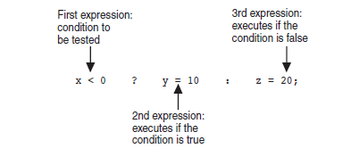
4.11 The Conditional Operator
This can be used to create short if/else statements
Format: expr ? expr : expr;
4-<number>

Slide 50
The Value of a Conditional Expression
A conditional expression is an expression that uses a conditional operator
The value of a conditional expression is determined by whichever of the subexpressions is executed
int num = 13;
string result= (num%2 ==0) ? "even" : "odd";
cout << num << " is " << result;
4-<number>
Notes:
See pr4-22.cpp

Slide 51
4.12 The switch Statement
Is uses the value of an integer expressiion to determine the statements to execute
It may sometimes be used instead of if/else if statements
4-<number>

Slide 52
switch Statement Format
switch (IntExpression)
{
case exp1: statement set 1;
case exp2: statement set 2;
...
case expn: statement set n;
default: statement set n+1;
}
4-<number>

Slide 53
// This program demonstrates how a switch statement
// works if there are no break statements.
_{#include <iostream>}
_{using namespace std;}
_{int main()}
{
_{char choice;}
_{cout << "Enter A, B, or C: ";}
_{cin >> choice;}
_{switch (choice)}
{
case 'A': cout << "You entered A.\n";
case 'B': cout << "You entered B.\n";
case 'C': cout << "You entered C.\n";
default : cout << "You did not enter A, B, or C!\n";
}
_{return 0;}
}
1-<number>

Slide 54
switch Statement Requirements
IntExpression must be an integer variable or a char,or an expression that evaluates to an integer value
exp1 through expn must be constant integer type expressions and must be unique in the switch statement
default is optional but recommended
4-<number>

Slide 55
How the switch Statement Works
IntExpression is evaluated
The value of intExpression is compared against exp1 through expn.
If IntExpression matches value expi, the program branches to the statement(s) following expi and continues to the end of the switch
If no matching value is found, the program branches to the statement after default:
4-<number>

Slide 56
The break Statement
Is used to stop execution in the current block
It is also used to exit a switch statement
It is used to execute a single case statement without executing statements following it
4-<number>
Notes:
See pr4-23.cpp, pr4-24.cpp, pr4.25.cpp, and pr4-26.cpp

Slide 57
Example switch Statement
switch (temp)
{
case ‘c': cout << “cold";
break;
case ‘h': cout << “hot";
break;
default : cout << “Neither cold nor hot";
}
4-<number>

Slide 58
Using switch with a Menu
A switch statement is a natural choice for a menu-driven program
  display menu
  get user input
  use user input as IntExpression in switch
  statement
  use menu choices as exp values to test against in the case statements
4-<number>
Notes:
See pr4-27.cpp

Slide 59
4.13 Enumerated Data Types
Is a data type created by the programmer
Contains a set of named integer constants
Format:
enum name {val1, val2, … valn};
Examples:
enum Fruit {apple, grape, orange};
enum Days {Mon, Tue, Wed, Thur, Fri};
4-<number>

Slide 60
Enumerated Data Type Variables
To define variables, use the enumerated data type name
  Fruit snack;
  Days workDay, vacationDay;
A variable may contain any valid value for the data type
  snack = orange; // no quotes
  if (workDay == Wed) // none here
4-<number>
Notes:
See pr4-28.cpp

Slide 61
Comparison of Enumerated
Data Type Values
Enumerated data type values are associated with integers, starting at 0
enum Fruit {apple, grape, orange};
You can override the default association
  enum Fruit {apple = 2, grape = 4,
  orange = 5};
0
1
2
4-<number>

Slide 62
Enumerated Data Type Values
Enumerated data type values can be compared using their integer values
if (snack == 1)
Enumerated data type values cannot be assigned using their integer values
  snack = 2; // won’t work
4-<number>

Slide 63
Enumerated Data Type Notes
Enumerated data types improve the readability of a program
Enumerated variables can not be used with input statements, such as cin
An enumerated variable will not display the name associated with the value of an enumerated data type if used with cout
4-<number>

Slide 64
In-Class Assignment Chapter 4
Book Club points An online book club awards points to its customers based on the number of books purchased each month. Points are awarded as follows:
Write a program that asks the user for the number of books purchased this month and displays the number of points awarded. Use if-else logic.
Write the program again using switch.
Books Purchased | Points Earned
0 | 0
1 | 5
2 | 15
3 | 30
4 or more | 60
1-<number>

